Slide 1
Jason Burwen
Vice President of Policy
September 17, 2019
Scaling Up Storage
Raab Roundtable

Slide 2
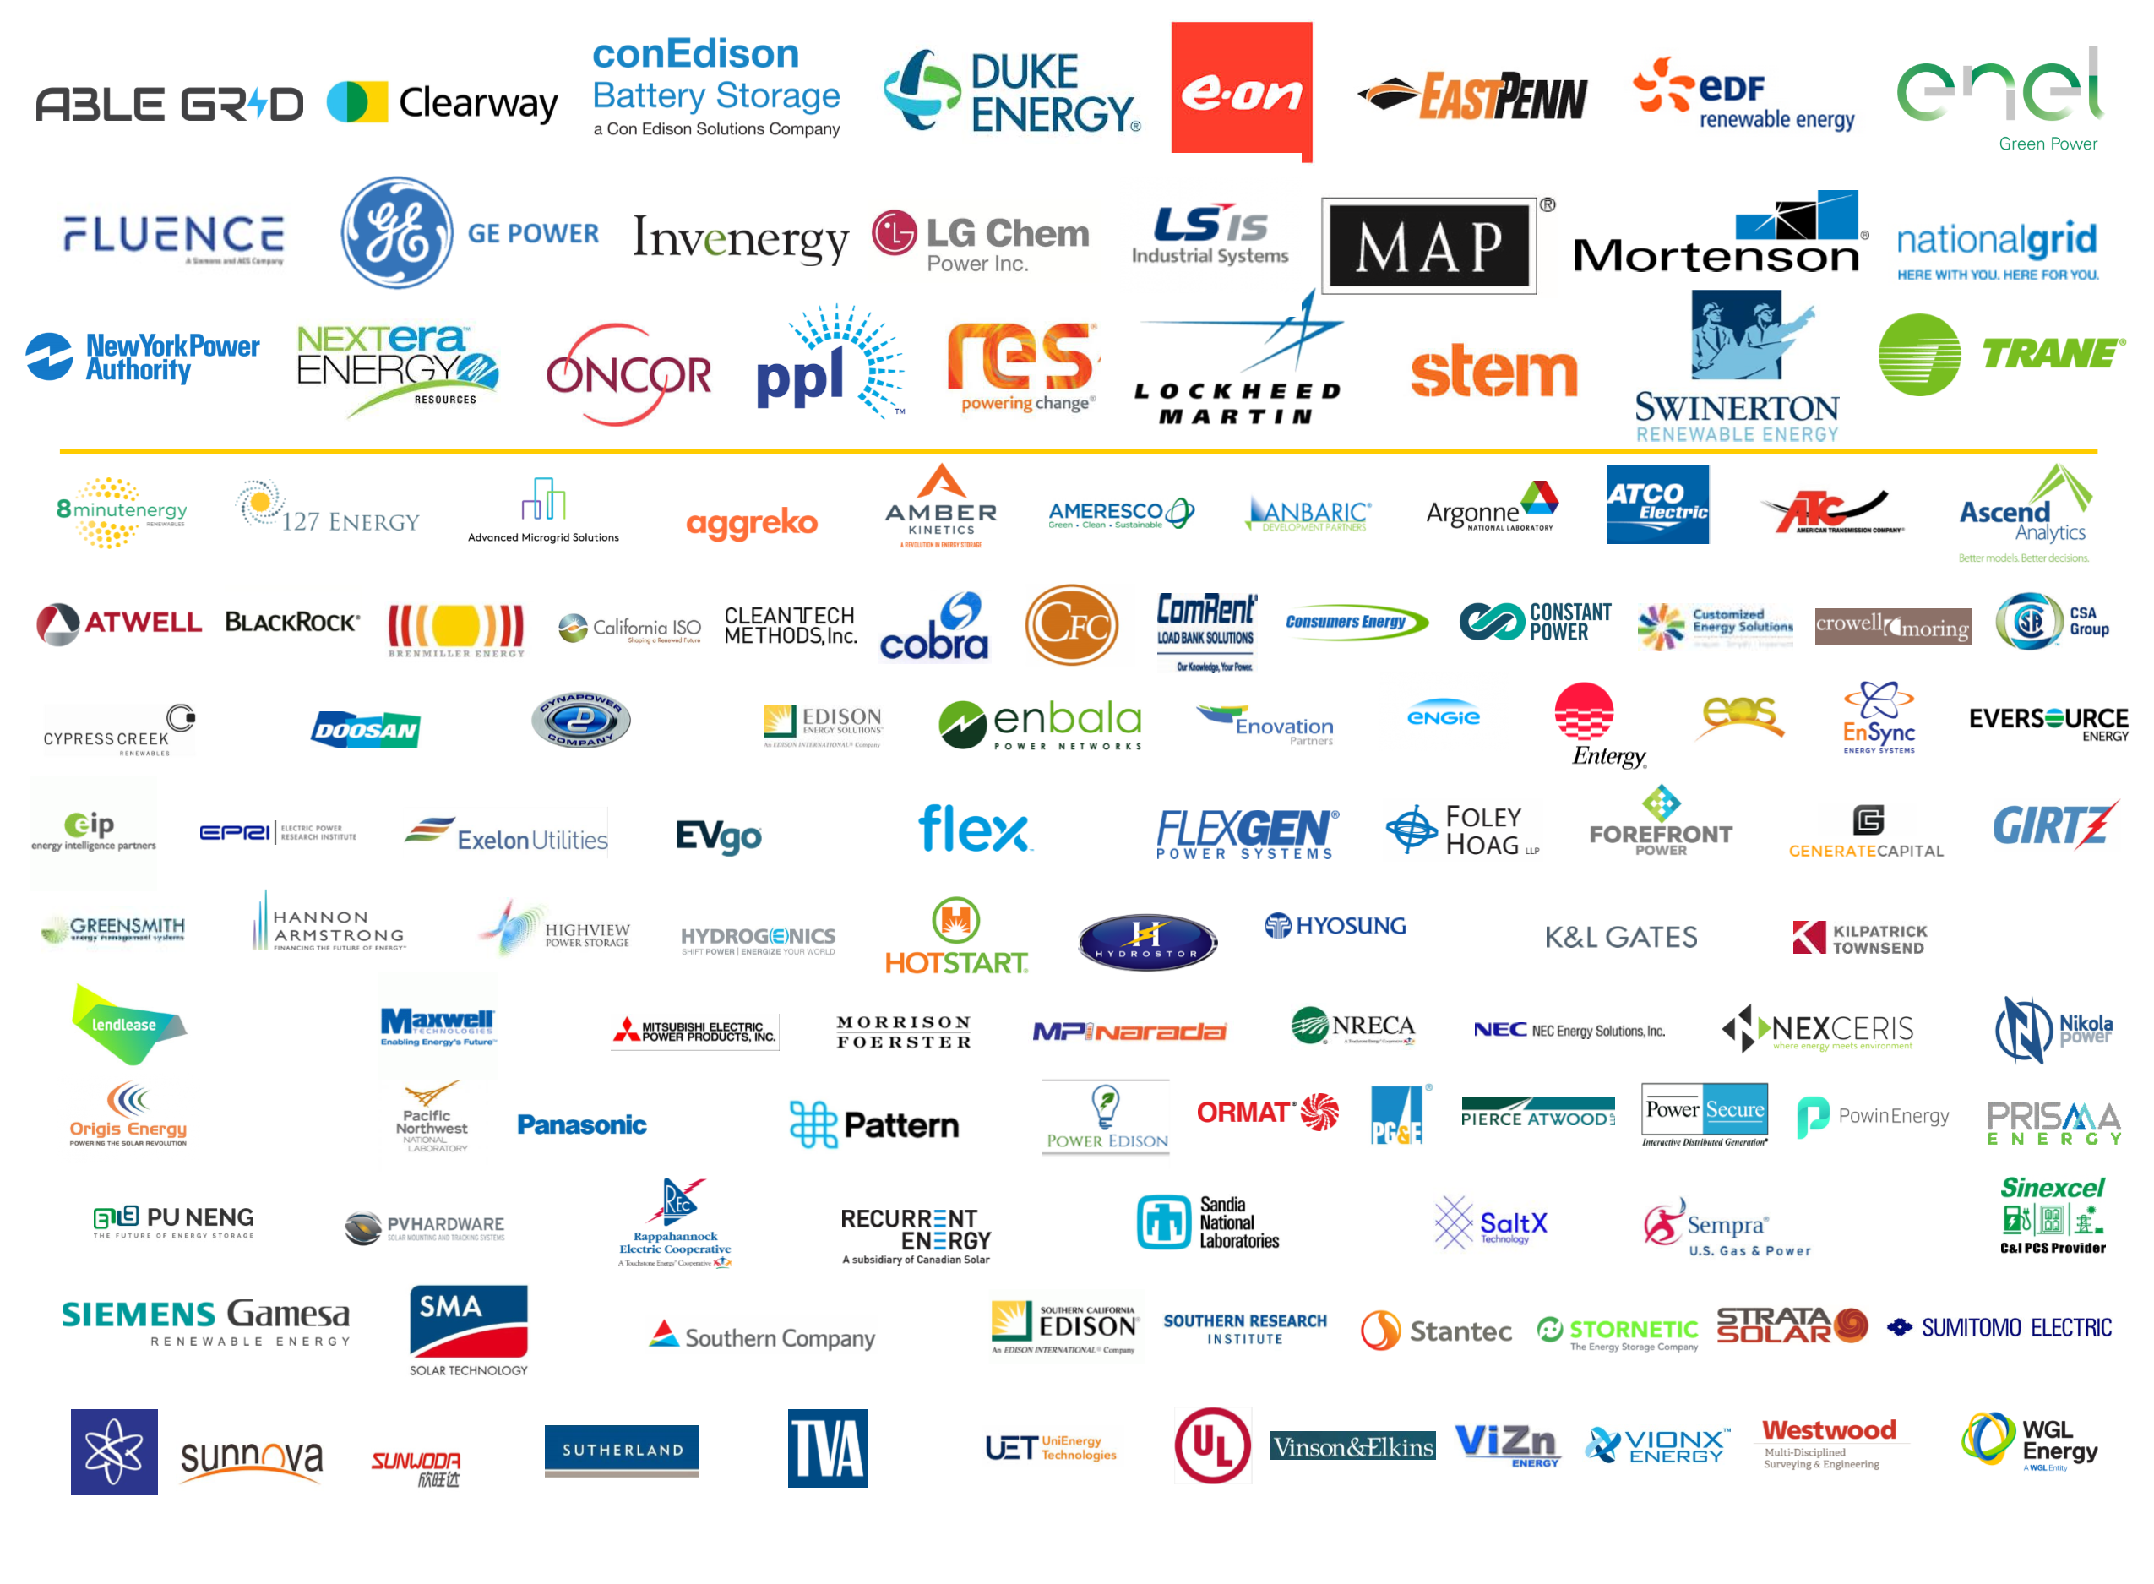
Our Members
manufacturers
component suppliers
system integrators
developers
independent generators
electric utilities
large end-users
law, finance, consulting
Technologies represented
battery storage
thermal storage
mechanical storage
power-to-gas storage

Slide 3
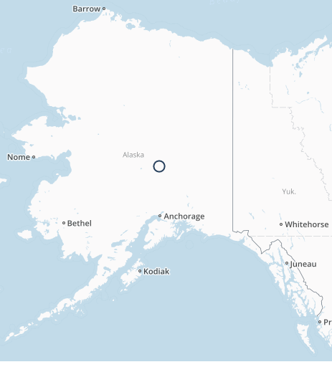
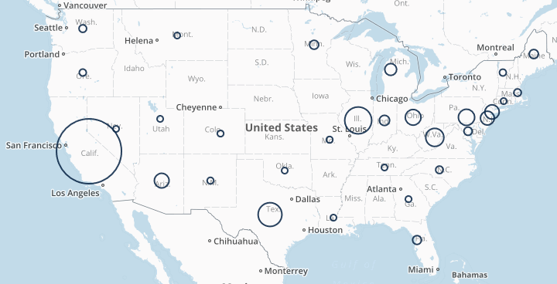
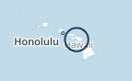
U.S. grid battery storage now past the 1 GW mark
Battery Storage MW Operational and in Development, Dec 2018
End of 2018: 1 GW (2 GWh) batteries online
+ 22 GW pumped hydro storage

Slide 4
Battery storage installed costs continue to drop
Bulk-scale 4-hour lithium-ion battery installed cost ($/kW)
Cost declines of 8-10% year-on-year expected through mid 2020s
Notes:
Nitzan
(we may add a slide on cost-effectiveness today)

Slide 6
As storage costs go down, size & duration go up
2012:
36 MW, 40 min battery in ERCOT
2016:
30 MW, 4 hour battery in SDG&E
2020:
300 MW, 4 hour battery in PG&E (approved)
2017:
100 MW, 75 min battery in Australia
2008:
1 MW, 15 min battery in PJM
Shift from primarily providing ancillary services to increasingly providing capacity / resource adequacy
All battery storage installed 2003-2017:
800 MW / 1200 MWh
Single PG&E battery in 2020:
300 MW / 1200 MWh
DER storage aggregations
to follow
(largest today ~20 MW)

Slide 7
Storage as a mainstream capacity option

Slide 8
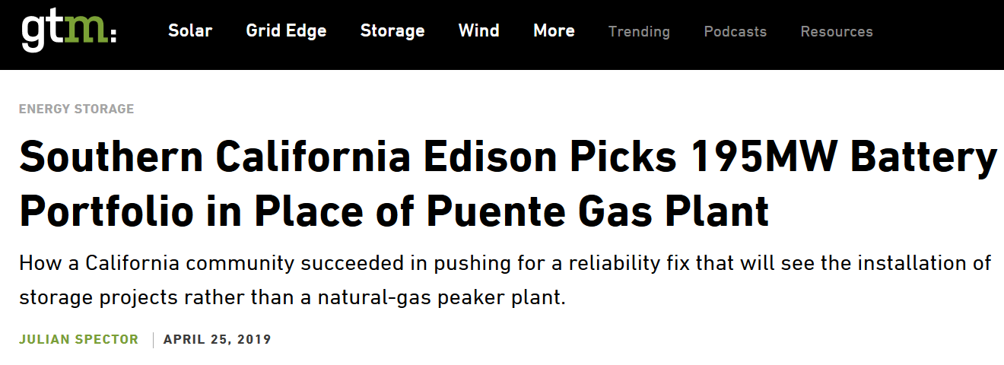
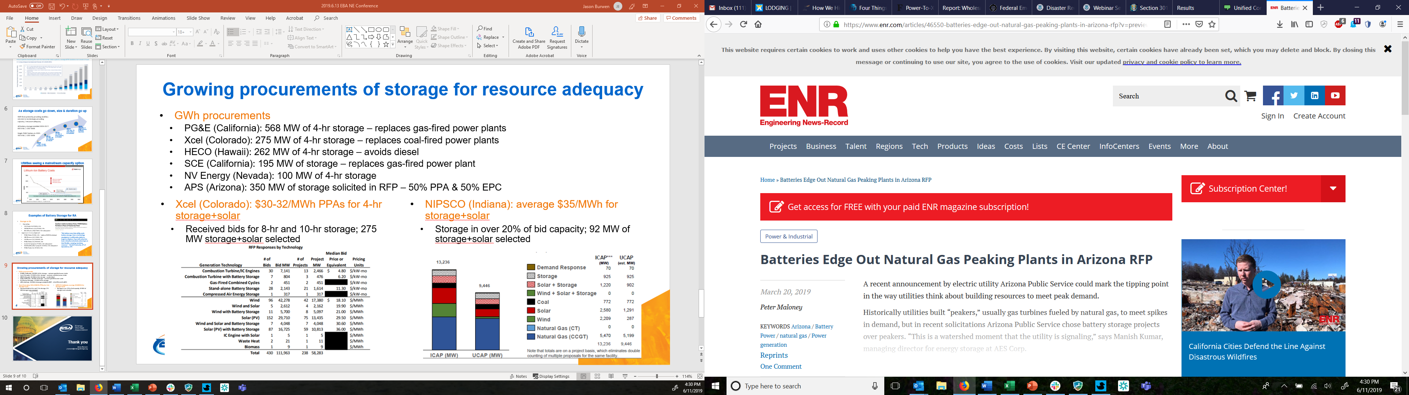
Examples of power plant sized batteries
Operating
  SCE/Tesla (CA) 20 MW, 4-hr
  SDG&E/Fluence (CA) 30 MW, 4-hr
  KIUC/Fluence (HI) 20 MW, 5-h
Approved / in development
  PG&E/Vistra 20 MW, 4-hr
  SRP/Fluence (AZ) 10 MW, 4-hr
  SCE/Fluence (CA) 100 MW, 4-hr
  PG&E (CA) 562 MW, 4-hr
  Xcel (Colorado): 275 MW, 4-hr
  HECO (Hawaii): 262 MW, 4-hr
  NV Energy (Nevada): 100 MW, 4-hr
"We believe now that utility-scale battery storage, from a technology standpoint, is sufficiently viable to begin to displace, if you will, what has been virtually exclusively natural gas as that flexible, ramping, backstop resource.”
-- Daniel Froetscher, VP of Operations, APS

Slide 9
Grounding the conversation
State actions to drive storage will influence RTOs
RTOs doing work, running into issues
  841 specific
  Beyond 841
Themes to come
  State & federal authority
  Competition

Slide 10
Thank you!
Jason Burwen
j.burwen@energystorage.org

